Slide 1


STAFF FLUENCY TRAINING · SESSION 1
What fluency is,
and why we teach it
Two children who can both read. Neither can tell you the story. This session is about what is really going on, and why it is ours to fix.
Reading Fluency · Staff training
Notes:
Welcome. This is the first of a short series of training sessions on reading fluency. Today is not about techniques. Today is about two questions: what fluency actually is, and why we should be teaching it in our school. Next time, we get practical. I want to start not with a definition but with two children. You will recognise them.

Slide 2

TWO CHILDREN
Two children who can both read
Priya
Felix
Reads at home because she wants to
Fast. I asked her to slow down
Skipped every full stop
Misread words she can read perfectly well
Remembered a dog. There is no dog in the story
Works harder at reading than Priya does
Word perfect
Sounds out almost every word, most behind his eyes
Each word is a small separate job
Nothing left at the end for what it said
Both met the phonics check threshold. Ask either family and you will be told their child can read.
Staff fluency training 1 · What fluency is
2
Notes:
Priya is one of our most enthusiastic readers. She reads at home because she wants to. She will tell you what she is halfway through without being asked. And she is quick. I sat with her and one of our Mystery Club stories and she read at a rate I ended up asking her to slow down for, and I do not ask that of many children. Then I asked her what had happened. She could not tell me much. She remembered the coins and that they had gone missing, but not whose they were or why anybody minded. There was a dog, she said. There is no dog in that story. The speed had cost her the meaning. She misread a handful of words she can read perfectly well when she is not racing. She did not mark a single full stop. She read the page the way you read a list. Felix works harder at reading than Priya does, because he badly wants to get it right. And he does get it right. He can be word perfect. But he gets there by sounding almost every word out, a few aloud and most somewhere behind his eyes. He finishes each word as a small separate job, then starts the next one, and by the end of the paragraph he has spent everything he has on the words and has nothing left for what they said. Both of them met the phonics check threshold. Ask either family and you will be told their child can read. And they can, in one sense. They are six.

Slide 3
From the outside, both look like the same thing: two children who read the words and did not understand the story. Both get filed under comprehension. Both get the same worksheet.
This is not a matter of comprehension.
It is a matter of fluency.
Notes:
And here is the trap. If we are not careful, both of these children get filed under comprehension and handed the same worksheet. From the outside that is exactly what it looks like they need: two children who read the words and did not understand the story. But this is not a matter of comprehension. It is a matter of fluency. And the two children need completely different things, which we will come to. Hold on to Priya and Felix. They stay in the room for the rest of this session.

Slide 4
FLUENCY
What fluency is
Reading fluency is the ability to read words correctly, to recognise them without effort, and to say them in the groupings and with the emphasis that carry the sense.
Accuracy
Automaticity
Prosody
Reading the word on the page. Not a guess, not a near miss.
Recognising it on its own, before the child decides to do anything.
The sound the words make: phrasing, emphasis, the rise and fall.
The settled definition since the National Reading Panel gathered the evidence in 2000. Almost nobody serious has argued with it since.
Staff fluency training 1 · What fluency is
4
Notes:
So what is fluency? Reading fluency is the ability to read words correctly, to recognise them without effort, and to say them in the groupings and with the emphasis that carry the sense. Three things. Accuracy, automaticity, prosody. Get those three working together and the child can understand what they have read. This has been the settled definition since the National Reading Panel in America gathered up the evidence at the turn of the century. Almost nobody serious has argued with it since. But almost none of it ever reached a timetable. The part that comes after decoding, where the words get easy enough to think with, sat in the research and rarely made it into anybody's week. We are going to take the three one at a time, with Priya and Felix still in the room.

Slide 5
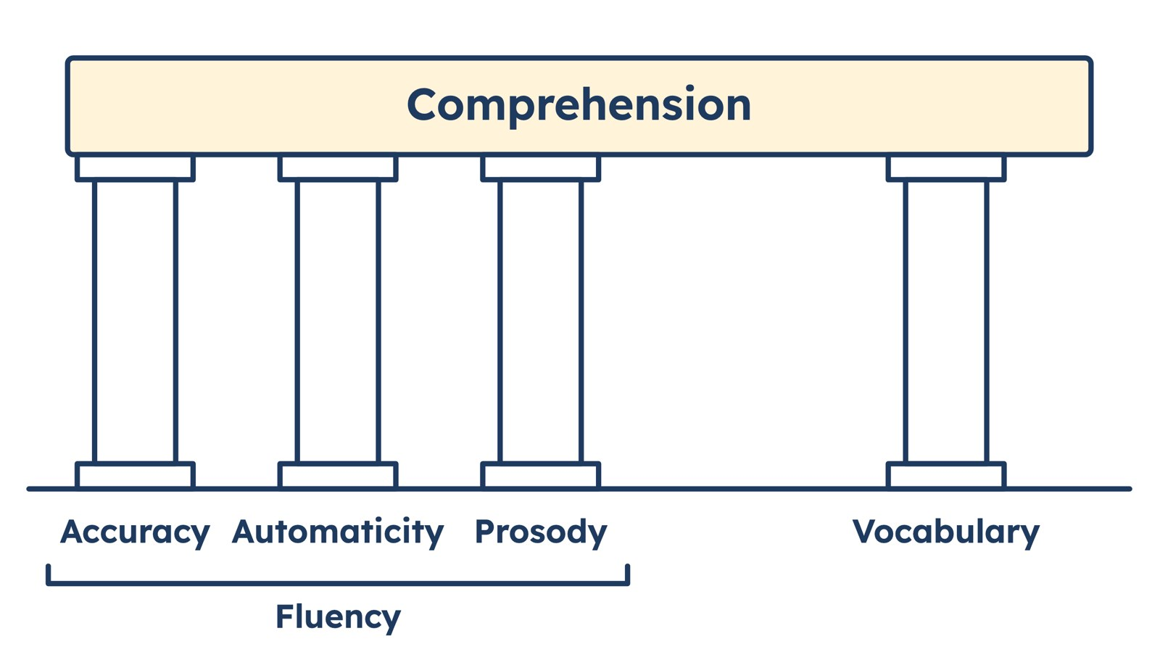
FLUENCY
Three pillars, one more pillar, and a roof
Staff fluency training 1 · What fluency is
5
Notes:
Here is the picture I want you to keep in your heads. Three fluency pillars: accuracy, automaticity, prosody. One more pillar standing a little apart: vocabulary. And the roof, which is comprehension. Vocabulary is not part of fluency. But comprehension needs it, and it matters more and more as children get older. We will come back to that. For today, the three on the left are our job. Take a pillar away and the roof comes down. And admiring the roof will not put the pillar back. That is what a comprehension worksheet does with a child like Felix: it admires the roof.

Slide 6
PILLAR ONE
Accuracy is the part we already teach
The child reads the word on the page. Not a word that starts the same way, not a good guess from the picture. The word.
A well-taught systematic phonics programme delivers this to the great majority of children. We are better at it than we have ever been.
THE WORKING NUMBERS
95%
About one error in twenty words. The level a child can learn from.
90%
Below this, the errors start changing what the sentences mean.
Rasinski, 2004
Staff fluency training 1 · What fluency is
6
Notes:
Accuracy first, because it is the one we already teach. The child reads the word on the page. Not a word that starts the same way, not a good guess from the picture. The word. We are better at this than we have ever been. A well-taught systematic phonics programme delivers accuracy to the great majority of children, and ours does. The working threshold is around ninety-five per cent on a given text, roughly one error in every twenty words. Below about ninety per cent the errors start changing what the sentences mean, and no child can understand a passage they are partly rewriting as they go. Between those two figures is where most useful teaching sits. Felix has accuracy in full. If the only thing I point at him asks whether he can decode, he comes back clean every time, while I carry on wondering why he cannot answer a question about the passage. You know the sentence that gets said about children like him at parents' evening: he can read, he just does not understand it. It is half right. And the half it gets wrong is the half you can teach. Priya's errors were not decoding errors either. She can read every word she got wrong. She got them wrong because she was travelling too fast to look properly. So a fall in accuracy does not always mean a child needs more phonics. Sometimes it means they have found a speed the rest of their reading cannot match.

Slide 7
PILLAR TWO
Automaticity is recognition that happens on its own.
You did not choose to read this sentence. You looked at it and could not help it.
Attention is finite. Everything a child spends getting a word off the page is unavailable for everything else the sentence is asking of them.
Your first driving lesson
Steering straight. Checking the mirror. Finding, or crunching, the gear. Each one took your whole attention. You could not hold a conversation.
Conversation became available when the steering stopped demanding anything.
The sentence a child cannot think about is usually the sentence they are still steering.
Staff fluency training 1 · What fluency is
7
Notes:
Automaticity is recognition that happens on its own, before the child has decided to do anything about it. You did not choose to read the sentence on this slide. You looked at it and could not help it. Attention is finite and it does not stretch on request. Everything a child spends on getting a word off the page is unavailable for everything else the sentence is asking of them: holding its beginning in mind while they reach its end, noticing that a name has come round for the second time, wondering why the coins matter. A child who is still decoding has not chosen to think less about the story. There is just nothing left to think with. Think about your first driving lessons. Steering straight, checking the mirror, finding the gear, or crunching it. Each of those things took your whole attention. You could not hold a conversation while you did them. Conversation became available when the steering stopped demanding anything. The sentence a child cannot think about is usually the sentence they are still steering. Felix is that child. He is accurate and he is slow, and the slowness is not a character trait or a shortage of effort. Every word is a small act of construction, and thirty of those in a row will exhaust anybody. Asking him then about the text is asking him to spend again what the words already cost him. And here is the thing. Automaticity has nowhere to live. Accuracy has phonics. Comprehension has an entire industry of questions and worksheets. Automaticity has never been anybody's job, partly because it leaves nothing behind, and partly because we have quietly assumed it arrives by itself once decoding is secure. For some children it does. For Felix, and for a great many others, it does not. Ask yourselves: how many Felixes have we got on a comprehension intervention right now?

Slide 8
PILLAR THREE
Prosody is the sound the words make
Where the voice rises and falls. Which words take the weight. Where the reader breathes. How words gather into groups before they are said.
Written English leaves out almost everything speech carries for free. The reader has to put it back.
Understanding, performed
Deciding that into the garden belongs together as one piece is understanding.
A child who reads a sentence with the right shape is showing you they have worked out its structure. A child who reads it flat is showing you they have not.
So teach expression directly, and teach it out loud.
Staff fluency training 1 · What fluency is
8
Notes:
Prosody is the music of reading: where the voice rises and falls, which words take the weight, where the reader breathes, how words gather into groups before they are said. Written English leaves out almost everything speech carries for free, and the reader has to put it back to understand the sentence at all. Deciding that "into the garden" belongs together as one piece is understanding, performed. A child who reads a sentence with the right shape is showing me they have worked out its structure. A child who reads it flat, or breaks it in the wrong places, is showing me they have not. So many children read a page perfectly well and tell you nothing about it, because they have turned print into sound without ever turning it into shape. Priya's punctuation is the example. She did not pause at the full stops, so one sentence ran into the next and the next, and the moment the story turned on went past inside a paragraph that never changed pace or pitch. She had automaticity in abundance and she used it to get to the end. So we teach expression directly, and we teach it out loud. Let me show you what I mean.

Slide 9

PROSODY
One sentence, four ways
1
Accuracy missing
2
Automaticity missing
3
Prosody missing
4
Fluent
Staff fluency training 1 · What fluency is
9
Notes:
Take one sentence. "When the door finally opened, the dog shot past her legs and into the garden." I am going to read it four ways. Listen for the difference. One. Accuracy missing. [Read: "when the door found opened, the dog shut past her legs and in the garden."] Near enough to sound like reading, wrong enough to mean nothing in particular. The child is not being careless. They are reading what they got. Two. Automaticity missing. [Read every word right, every word separate, pauses between the words instead of between the ideas.] By the time the child reaches "garden", the door has gone. Felix reads like this. The giveaway is that he can often answer a question about the end of a sentence, and nothing before it. Three. Prosody missing. [Read it quick and flat, one line, one volume, a small breath in the middle for no reason.] The comma does no work. The full stop does no work. This is the one most easily mistaken for good reading. Four. Fluent. [Read: "When the door finally opened / the dog shot past her legs / and into the garden."] It arrives in pieces that mean something. "Finally" takes a little weight, because somebody has been waiting. The pace lifts on "shot past her legs". You can hear that the reader knows what happened, because the reading is the knowing. Real children are less tidy than four clean examples. Priya was losing accuracy and prosody at once, from one cause. I have separated them so you can learn the sounds, not because children turn up one fault at a time.

Slide 10
FLUENCY
Fluency is not something a child has or lacks
Hand anyone in this room a page of case law or the service manual for a boiler and their reading will slow, flatten and lose its shape inside a paragraph. Hand them a picture book and they are fluent again.
The text moved. They didn't.
So the useful sentence is not "Felix is a dysfluent reader". It is "Felix isn't yet automatic on texts at this level". That one tells you what to do on Monday.
Staff fluency training 1 · What fluency is
10
Notes:
One more thing before we move on to why. Fluency is not a fixed attribute a child has or lacks. It is what happens between a particular child and a particular text. Hand any adult in this room a page of case law or the service manual for a boiler and their reading will slow, flatten and lose its shape inside a paragraph. They will not have become a poor reader on the way to the photocopier. Hand them a picture book and they are fluent again. The text moved. They did not. That changes how we talk about children in meetings. "Felix is a dysfluent reader" is a shorthand, but not a useful one. The useful sentence is that Felix is not yet automatic on texts at this level, and that one tells me what to do on Monday. It also means fluency is never finished. It gets rebuilt at every jump in text difficulty. Which is why a child who looks secure in Year 2 can look laboured in Year 5 in front of a science text. Hold that thought, because it is exactly where we are going next.

Slide 11
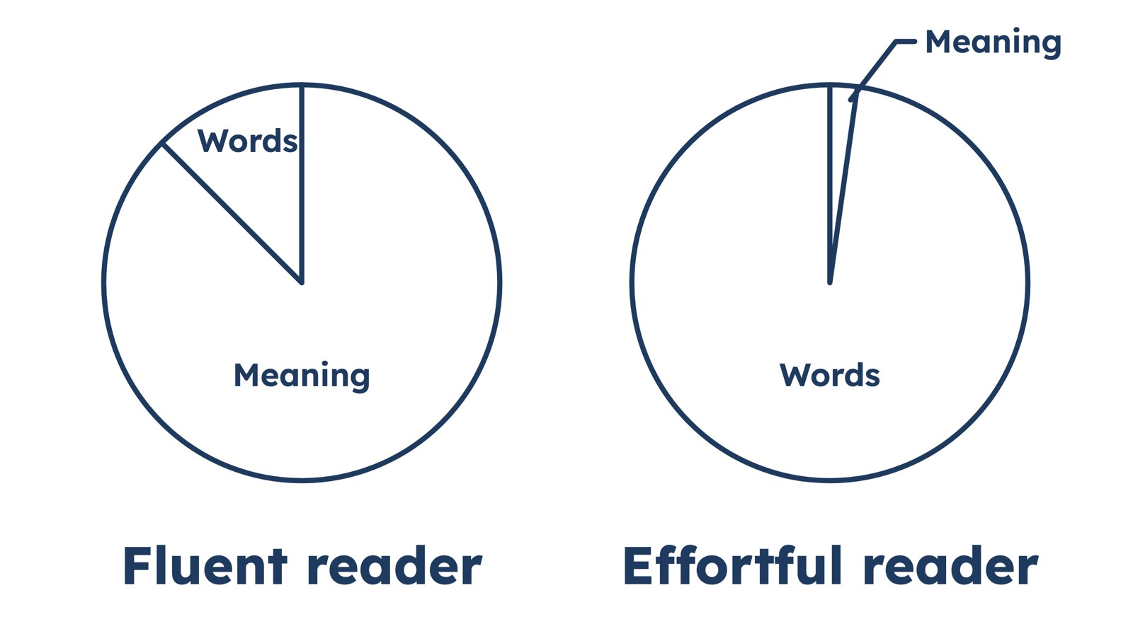
WHY FLUENCY
A reader is doing two jobs from one pool of attention
LaBerge and Samuels, 1974
The paper the whole of fluency research has stood on since. Nobody mentioned it in my teacher training, and I'd be surprised if they mentioned it in yours.
Staff fluency training 1 · What fluency is
11
Notes:
Now, why does this matter? Here is the mechanism, and it is simple enough to explain at a parents' evening. In 1974 two researchers, LaBerge and Samuels, published the paper the whole of fluency research has stood on since. Nobody mentioned them in my teacher training and I would be surprised if they came up in yours. A reader is doing two jobs at once: recognising the words, and understanding what the words mean. Both jobs draw on the same pool of attention. A reader who recognises words automatically, instantly, without deciding to, takes almost nothing from the pool for the first job, so nearly the whole pool is free for the second. A reader who is still working the words out keeps drawing on the pool for the first job, and the second job runs on whatever is left. On a demanding enough text, that is nothing at all. You have watched this happen. You met Felix twenty minutes ago. I bet you can name a dozen children like this that you have taught. [The bars on the slide are a picture of the idea, not a measurement. Do not quote the percentages.] Half a century of research has tested that account from every direction and it has held. The link between fluency and comprehension is one of the most measured relationships in the field, and it is strongest of all in the primary years. The relationship is at its most powerful in exactly the years we teach.

Slide 12
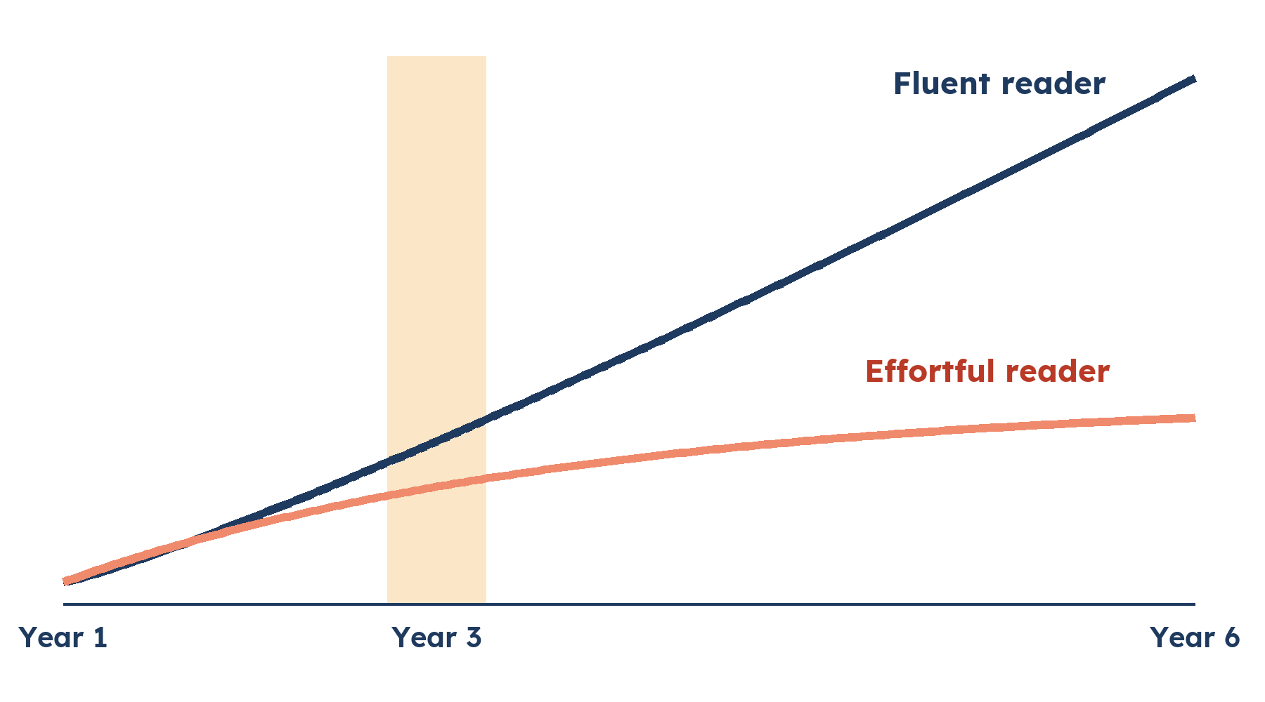
WHY FLUENCY
The Year 3 wall
Somewhere in the move from the infants to the juniors, everything gets harder at once:
• Books get longer, pictures thin out
• Sentences carry two ideas each
• Vocabulary turns academic: evaporation, peninsula, predator
• Print shrinks and packs tighter
• And reading teaching stops
Shape only. The lines diverge, the divergence speeds up, and it starts earlier than anyone notices.
Staff fluency training 1 · What fluency is
12
Notes:
This is the slide I most want you to remember, because it is about what happens to our children after they leave us. I do not know if the Year 3 wall has ever been coined officially, but I am sure many of you will recognise it. Somewhere in the move from the infants to the juniors, the difficulty level goes up, and it goes up for every child at once. The books get longer while the pictures thin out, so the support a struggling reader was leaning on is withdrawn by the publisher before anyone in school has decided anything. The sentences start carrying two ideas each, held together by "although" and "unless" and "which meant that". The vocabulary turns academic: "evaporation", "peninsula", "predator" arrive in print before they have ever arrived in a child's ear. Even the print itself shrinks. Any one of those a child could absorb. They come together, in the same term, often unannounced. And at the same moment, reading teaching stops, or at least changes significantly. It is not neglect and it is not laziness. A junior curriculum is enormous. Reading looks finished, because the children can decode and the data says so. So reading slides from being the lesson to being the tool for the lesson. Every hour of the week assumes the skill and no hour builds it. We take the scaffolding down at the moment we ask the building to go up three more floors. The unfair part is that the wall is almost invisible from the front of the room. When you drop in on a child's reading for a quick listen, her accuracy holds. What has changed is what every accurate word now demands of her, and the strain does not show in thirty seconds. So it gets put under other names: attention, attitude, ability at science. What we build in Key Stage 1 is what gets them over that wall. That is why this is our job, not just the juniors' job.

Slide 13
WHY FLUENCY
What the effort crowds out
Comprehension
Knowledge
Love of reading
The attention the words take is subtracted from the attention the meaning gets. The child who gives most to the words understands the least, however hard she concentrates.
And concentrating harder is what she is already doing.
The vocabulary that will carry her comprehension at eleven is being laid down, or not laid down, through the texts she can or can't manage at eight.
It shapes the reader she was going to become.
Look at who is curled up in the book corner at wet play. It will be the children who can already read. The child working twice as hard walks past it.
Fluency is the entry requirement nobody put on the poster.
Staff fluency training 1 · What fluency is
13
Notes:
Follow the effort through a school week and it crowds out three things. The first is comprehension. This is arithmetic more than metaphor. The attention the words take is subtracted from the attention the meaning gets, so the child who gives most to the words understands the least of the text, however hard she concentrates. And concentrating harder is what she is already doing. We notice the poor understanding rather than the effort behind it. So we file her under comprehension and prescribe more comprehension work. More questions, more inference practice, more of the thing she cannot yet reach instead of the thing that is stopping her reaching it. Asking her better questions about a text that is exhausting her is not teaching. It is assessment. The second is knowledge. The vocabulary that will carry her comprehension at eleven is being laid down, or not laid down, through the texts she can or cannot manage at eight. So effortful reading does not just make one lesson harder. It shapes the reader she was going to become. The third is the love of reading. Of the three, schools work hardest on this and I think we understand it the least. The children who read for pleasure are overwhelmingly the children for whom reading is easy. They read more, so it gets easier, so they read more again. Keith Stanovich called that the Matthew effect, after the line in the gospel about the rich getting richer. Now run the same spiral from underneath. A child for whom every page is a struggle is being asked to give her free time to the thing that makes her feel slow. When she declines, it is a reasonable response. We have all built book corners. Have a look on Monday at who is curled up in it at wet play. It will be the children who can already read. The child working twice as hard walks past it, and it is not your corner failing. The invitation just reads differently to her. Somewhere around Year 4 she stops saying reading is hard and starts saying she does not like it. So keep every cushion. Just do not expect the book corner to reach the children who find reading difficult. Fluency is the entry requirement nobody put on the poster.

Slide 14
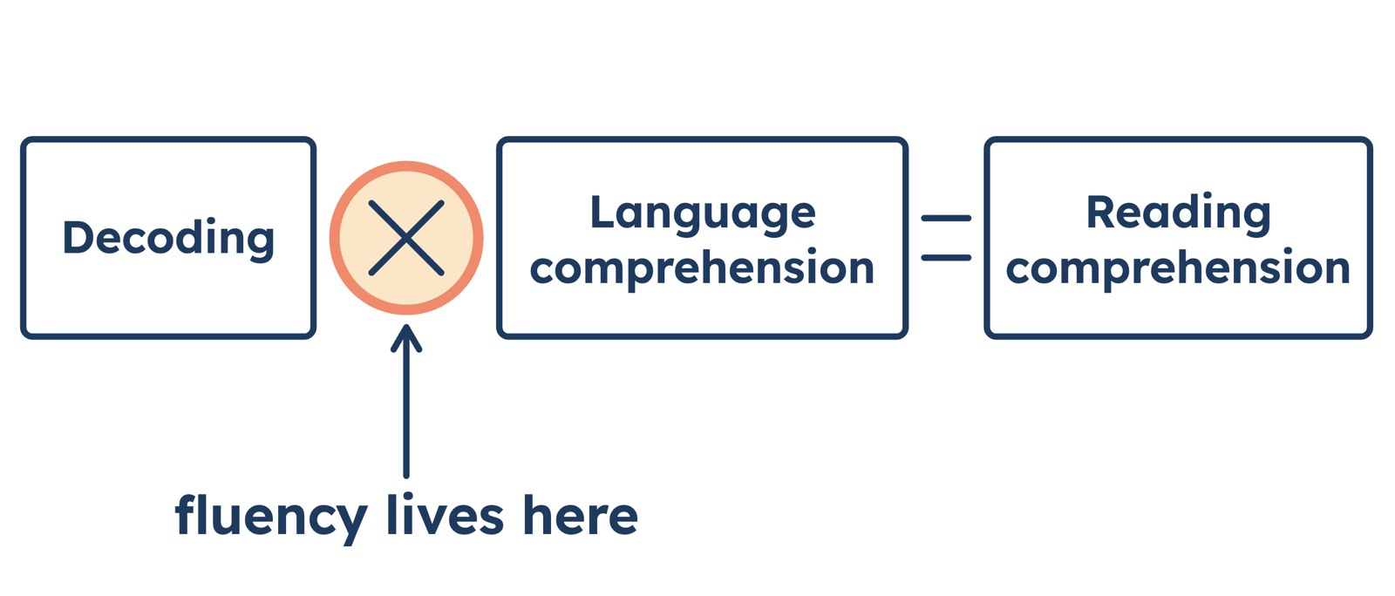
THE RESEARCH
You already know the Simple View of Reading. Where's fluency?
Gough and Tunmer, 1986. Scarborough's Reading Rope, 2001, writes the same thing in the small print: word recognition becomes "increasingly automatic".
Staff fluency training 1 · What fluency is
14
Notes:
Now for some of the research, because I know this staff, and I know you want to understand why before you change what you do. Most of you will have met the Simple View of Reading in phonics training. Gough and Tunmer's formula from 1986: reading comprehension is decoding multiplied by language comprehension. Two things multiplied, and if either is zero, the answer is zero. It is the frame the Reading Framework is built on and the one behind the phonics screening check. Now look at the formula again and ask: where is fluency? It is not in it. And that absence has shaped twenty years of English primary practice. We built magnificent machinery for the first term, systematic phonics. We built comprehension lessons for the second. The multiplication sign in the middle, where decoding has to become so effortless that all of a child's attention is free for meaning, got no slot on any timetable. Fluency is in the model, but it is written in the small print. Hollis Scarborough drew the same picture as a rope in 2001, and on the word-recognition side she wrote the phrase that matters: the strands become "increasingly automatic". That is fluency, inside the science's own labels. So when someone asks why we are spending curriculum time on fluency, this is the answer. Fluency is already in the science of reading. It is the part of it that school timetables have barely touched.

Slide 15
THE RESEARCH
Does teaching fluency actually move anything?
Herts for Learning, Key Stage 1
National Reading Panel, 2000
Around 600 children. In eight weeks: about a year and a half of comprehension age and eleven months of accuracy, on a standardised test.
Guided oral reading, an adult or stronger reader alongside the child, reading aloud and rereading, reliably moves word recognition, fluency and comprehension.
EEF and the Reading Framework
The children who struggle most
The EEF's Key Stage 1 literacy guidance puts fluency among its recommendations. The DfE's Reading Framework says weak fluency drags on comprehension across the curriculum.
Word-recognition and fluency difficulties may be the key concern for up to 90% of children with significant comprehension problems (Duke, Pressley and Hilden, 2004).
Staff fluency training 1 · What fluency is
15
Notes:
The question every headteacher asks first, and it is the right one: does teaching fluency actually move anything? A clear British answer comes from Herts for Learning. Their Reading Fluency Project has run in hundreds of schools. In Key Stage 1, across around six hundred children, the average child gained about a year and a half of comprehension age and eleven months of accuracy in an eight-week block, on a proper standardised assessment. Now, eight weeks does not really pour a year and a half into a child. Part of what a jump like that captures is teaching and test suddenly pulling in the same direction. But as a first answer to "is this worth my time", it will do. Step back to the whole field and the picture holds. The National Reading Panel in 2000 gathered up the studies on guided oral reading, an adult or a stronger reader alongside the child while they read aloud and reread, and found a consistent positive effect on word recognition, on fluency and on comprehension, in ordinary classrooms. And the companion finding: the practice that works is the guided kind. Not silent time with a book, not reading round the class. Here at home, the EEF's literacy guidance for Key Stage 1 puts fluency work squarely among its recommendations, and the Reading Framework says that skilled readers read effortlessly and that weak fluency drags on comprehension right across the curriculum. Ofsted's 2024 English report found the same gap from the other direction: schools securing decoding, then leaving fluency largely unaddressed. And for the children we worry about most: when researchers looked at struggling readers referred for reading support, the deficit that ran deepest was fluency, not word recognition and not comprehension. Duke, Pressley and Hilden went further: word-recognition and fluency difficulties may be the key concern for up to ninety per cent of children with significant comprehension problems. That is the research version of Felix.

Slide 16
PHONICS AND FLUENCY
Fluency is not a rival to phonics
Phonics
Fluency work
Teaches the code, at word level, in a specified sequence. Excellent at laying the building blocks for accuracy.
Happens on connected text: passages, poems, sentences that go somewhere. Begins as decoding becomes secure and runs alongside.
Nothing asks you to slow the programme, dilute it or shorten it. It collects what phonics delivers and makes it easy. Phonics is NECESSARY but it is not SUFFICIENT.
Staff fluency training 1 · What fluency is
16
Notes:
If part of you has been waiting for the catch, the moment I ask you to loosen something we have spent years tightening, there is not one. Nothing in this asks you to slow our phonics programme, dilute it, shorten it, or for the most part share its slot. Systematic synthetic phonics works, and fluency work is only possible because programmes like ours now deliver accurate decoding at scale. Phonics teaches the code, at word level, in a specified sequence, and it is excellent at laying the building blocks for accuracy. It is less good at teaching automaticity. The only thing I would say is that sometimes we ask children to persist with phonics for longer than they ought to, in the name of accuracy, when accuracy has stopped being the problem and automaticity has not. Fluency work happens on connected text: passages, poems, sentences that go somewhere. It begins as decoding becomes secure and runs alongside the programme, not instead of it, collecting what phonics delivers and making it easy. We do not have to choose between phonics and fluency. We choose whether the accuracy we have worked so hard to build becomes reading, or whether it stays a test score.

Slide 17
FOUR MYTHS
Four things fluency is not
1
Fluency isn't speed
2
Decoding doesn't deliver comprehension by itself
Speed is a symptom of automaticity, which is why we measure it. Chased for its own sake it takes accuracy and prosody down with it. Ask Priya.
Decoding gets the words right. Something else has to make them cheap.
3
Silent reading doesn't build fluency
4
Reading round the class builds little
An effortful reader left alone with a book practises being effortful. Defend the time if you like. Just don't count it as fluency teaching.
No chance to prepare, a halting model for everyone listening, and half of them counting ahead to find their paragraph.
Staff fluency training 1 · What fluency is
17
Notes:
Before we finish, four things fluency is not, because each of them is something we might already be doing in good faith. One. Fluency is not speed. Speed is a symptom of automaticity, which is why we measure it, and a measurable symptom is worth having. But pursued for its own sake, speed does more than fail to deliver comprehension. It takes the other two components down with it. Priya lost accuracy she already had and abandoned punctuation she can use perfectly well, and she did both by going faster. A child whose rate climbs while their accuracy falls is not improving. Two. Accurate decoding does not deliver comprehension by itself. This belief is why so many schools treat the reading job as finished when the phonics job is finished. Decoding gets the words right. Something else has to make them cheap. Three. Silent independent reading does not build fluency. Not reliably, and least of all in the children who most need it built. An effortful reader left alone with a book practises being effortful, or holds the page open and thinks about something else, and no adult in the room finds out which. It runs the other way round: fluent reading aloud feeds fluent silent reading. Defend independent reading time if you like. There are good reasons. Just do not count it as fluency teaching. Four. Reading round the class builds little. Picking children at random to read a paragraph aloud with no warning gives the child performing no chance to prepare and hands every child listening a halting model of the thing you want them to hear. Some of them are counting ahead to work out which paragraph will be theirs. Whatever they are learning in that lesson, it is not reading.

Slide 18
You have to listen to your children read to know how good a reader they are.
It takes time. It takes less time than you think. A whole class in an afternoon. Find out which of the three each child is weakest at. Then teach.
Notes:
This is where the Handbook begins (My teaching story): its author’s own headteacher, Jane Swingler, and her belief in one-to-one reading. You have to listen to your children read to know how good a reader they are. I make no apology for telling you that this takes time. But I promise you that you can do it in less time than you think. I have checked a whole class in an afternoon here. Find out which of the three fluency elements each child is weakest at. Then teach. Where does this leave Priya and Felix? Felix needs the words to cost him less, so there is something left to think with. Priya needs to slow down enough for the words to be worth having. Both are teachable, both can be taught daily, and neither is a worksheet.

Slide 19
NEXT TIME
What we do about it
• Listening to a child read, and what to listen for
• Modelled reading, echo reading and choral reading
• Rereading that children want to do: the poem and the performance
• Where Felix and Priya go from here
One thing to try before then: this week, listen to one child read for a whole minute, and decide which of the three pillars is the weakest.
Notes:
That is the why. Next time is the what: the actual routines. Listening to a child read and what to listen for. Modelled reading, echo reading and choral reading, which is where a fluent voice sits alongside the child. Rereading that children actually want to do, which means a poem and a performance. And where Felix and Priya go from here. One thing to try before then. This week, pick one child, listen to them read for a whole minute, not thirty seconds, and decide which of the three pillars is the weakest. Accuracy, automaticity or prosody. Bring the name and your answer next time. Thank you.

